Slide 1
The Potato Bed is YOURS!

Slide 2
Cover Crop: What and Why?

Slide 3
Green Manure? Cover Crops are great because they...
fix nitrogen
protect soil from rain/runoff
add organic matter to the soil
suppress weeds

Slide 4
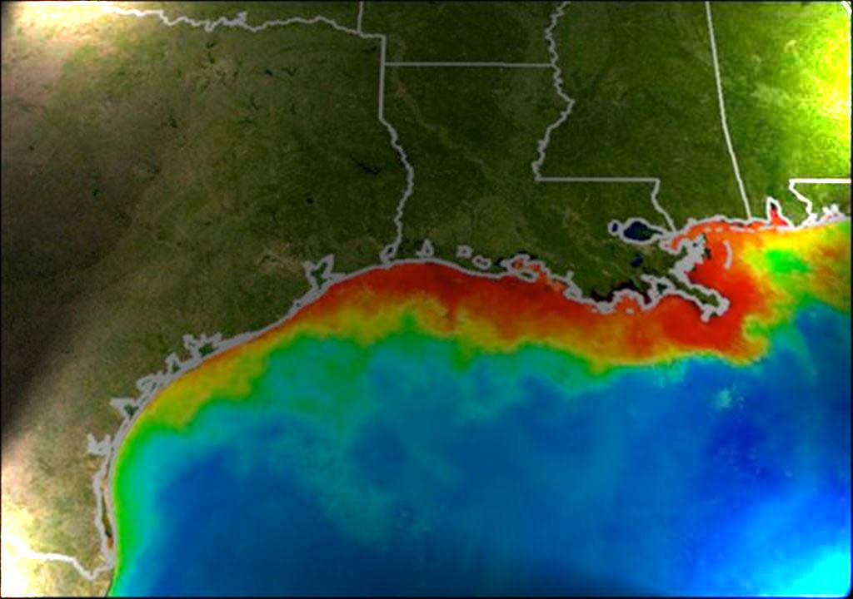

Slide 5
http://www.gulfhypoxia.net/Overview/hypoxia_flash.asp

Slide 6
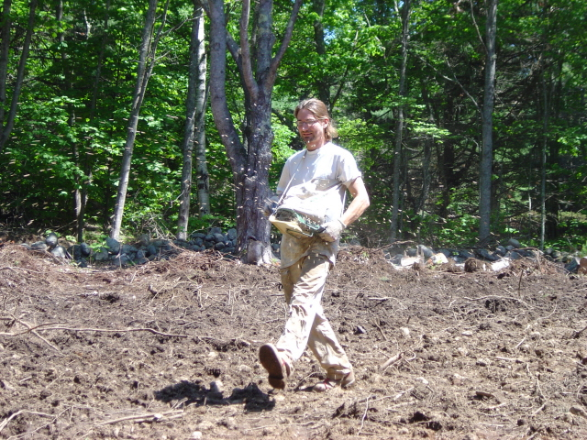
THE PLAN
Turn and smooth soil
Broadcast seed
Cover seed with soil
Water
Wait...until spring
Turn crop into soil
Wait 3 weeks.
Plant Potatoes

